Slide 1
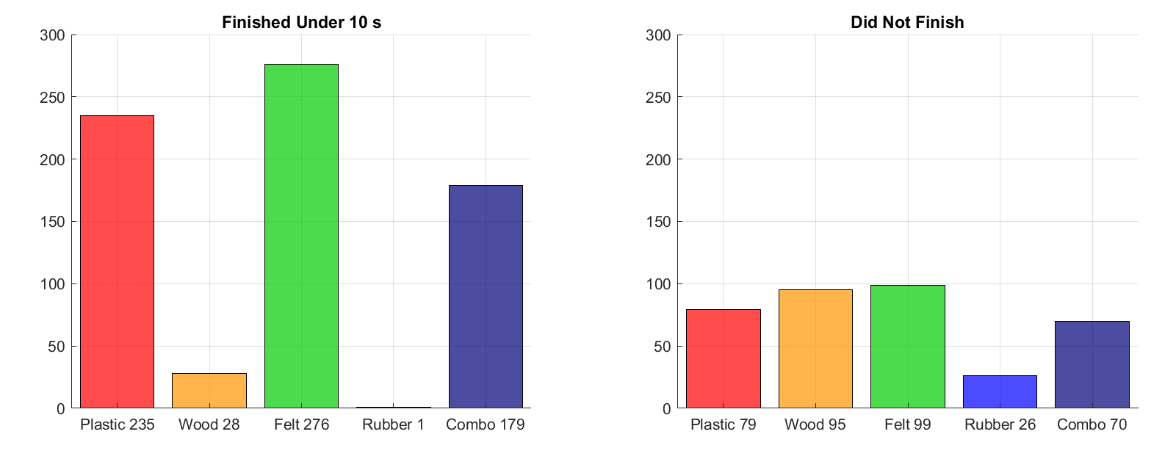
Total Runs by Material
When only one track was in use, the other, whatever its configuration, ‘did not finish’, so some of these may not have represented actual runs
Over ¾ of wood did not finish the course. Rubber reliably did not finish.

Slide 2
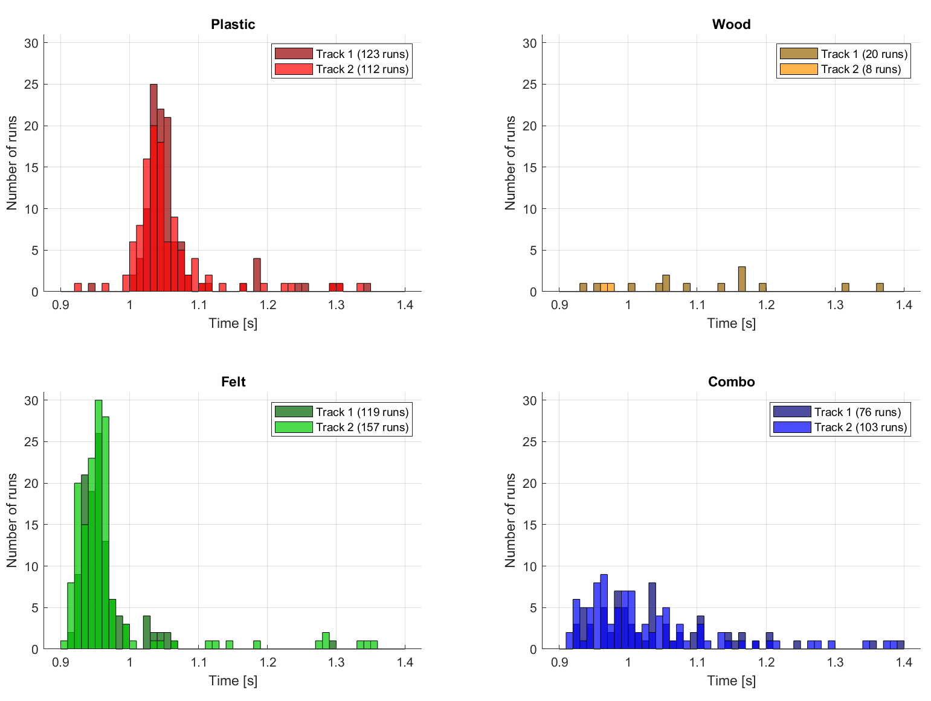
Frequency of Finish Time by Material
Felt is faster than plastic by ~0.08 s on average (each bar represents 0.01 s)
Felt and plastic have similar standard deviations in finish time
Both tracks show the same trends and have the same mode finish time (bin size 10 ms)

Slide 3
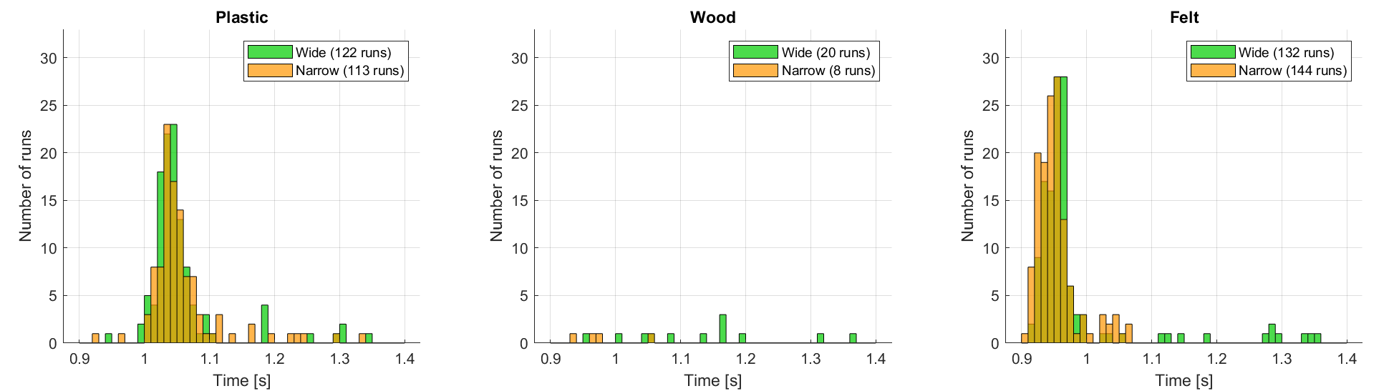
Frequency of Finish Time by Width
Mean finish time for narrow slightly faster than for wide for all materials
Results for wood are not statistically significant
Felt shows the most significant separation by width

Slide 4
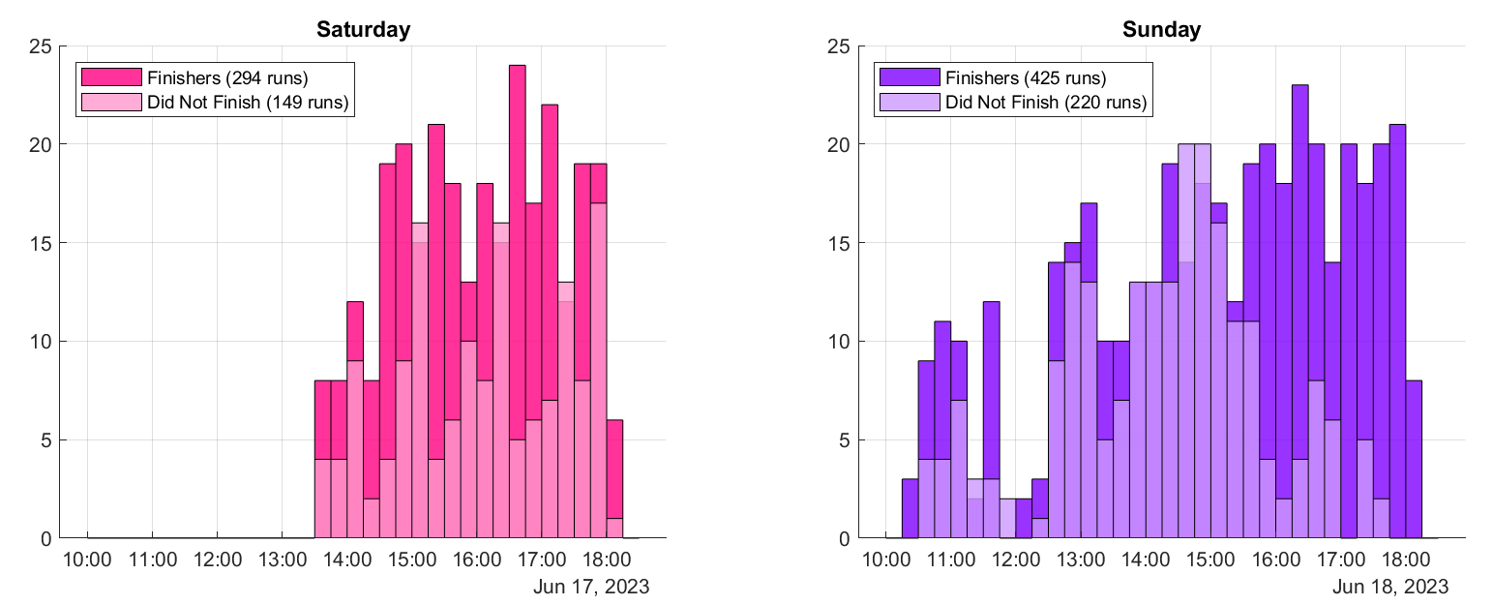
Activity Distribution by Time of Day
Regrettably, data from before lunchtime on Saturday was not recorded
The event officially opened 1100-1800

Slide 5
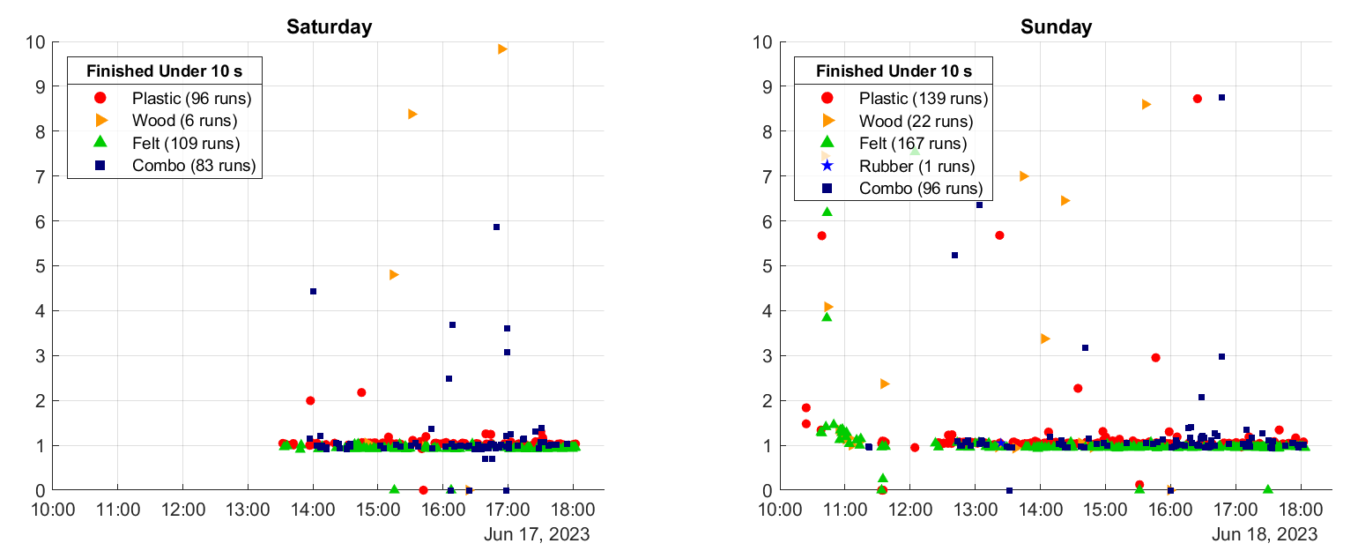
Runs finishing in under 10 s
Runs taking more than 2 seconds occurred when cars did not finish but were not left for the full 10s, or due to other anomalies

Slide 6
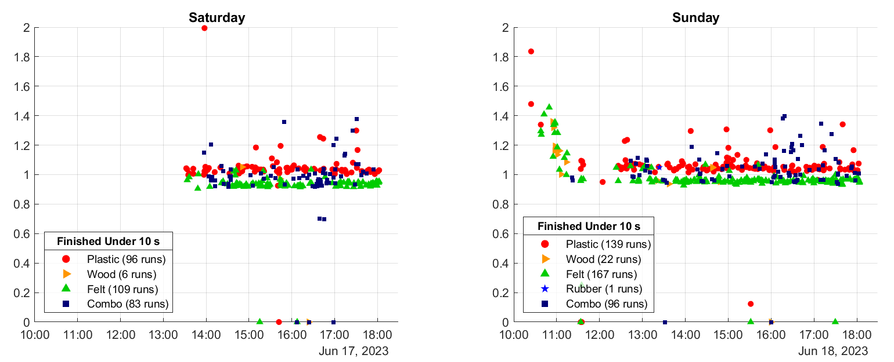
Runs finishing in under 2 s
On Sunday the track had been cleaned overnight and for the first hour, finish times were appreciably longer until it became greasy again!

Slide 7
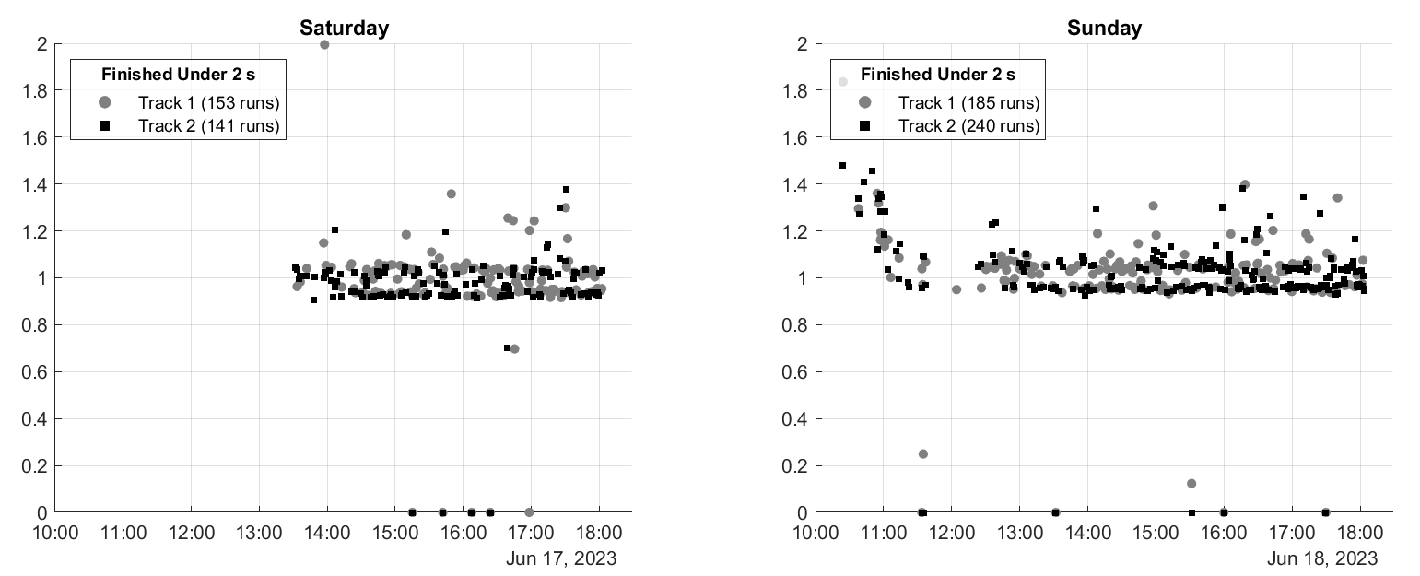
Runs finishing in under 2 s by Track

Slide 8
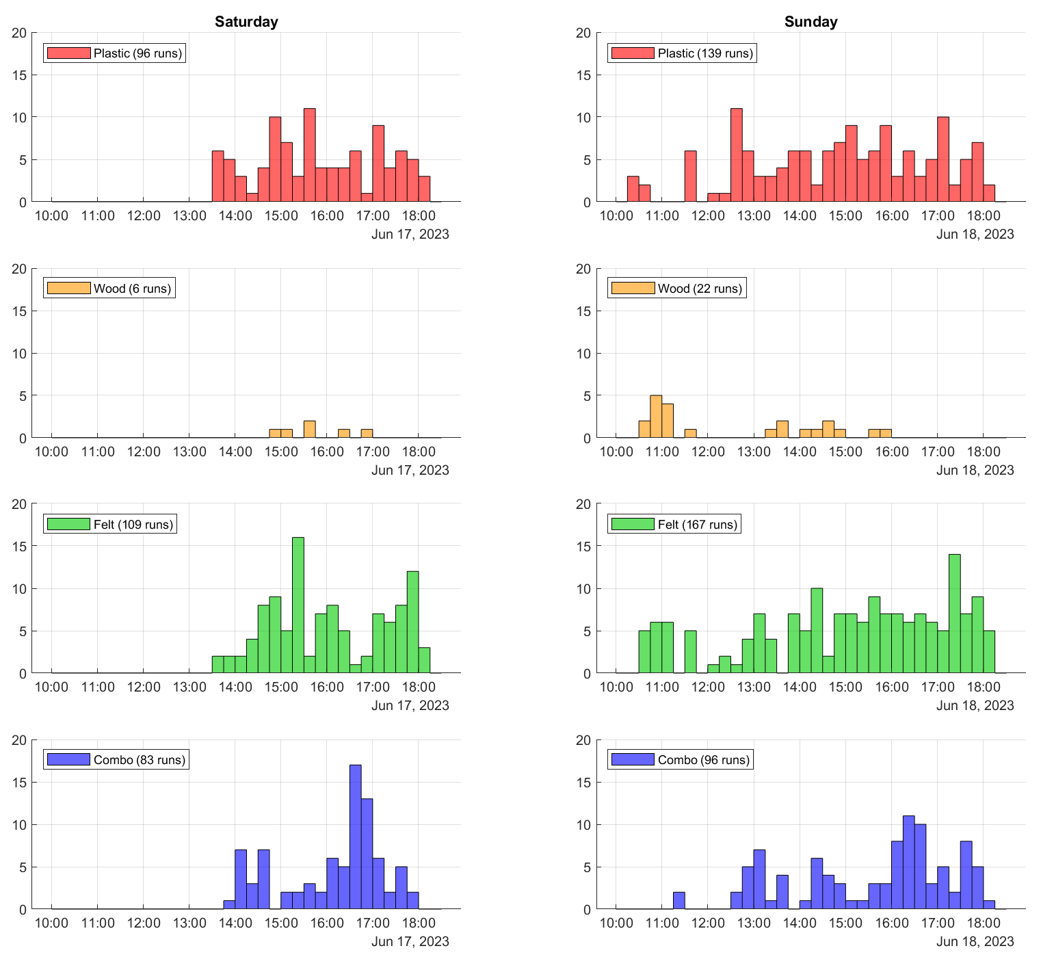
Distribution of Finishers by Material
Visibility of leaderboard (showing felt to be most successful) and perhaps also intuition, created a consistent bias towards the faster materials
At approx. 1630 on both days, there was a spike in popularity of combos
This may coincide with the time that people’s uncles started joining in and trying to be clever

Slide 9
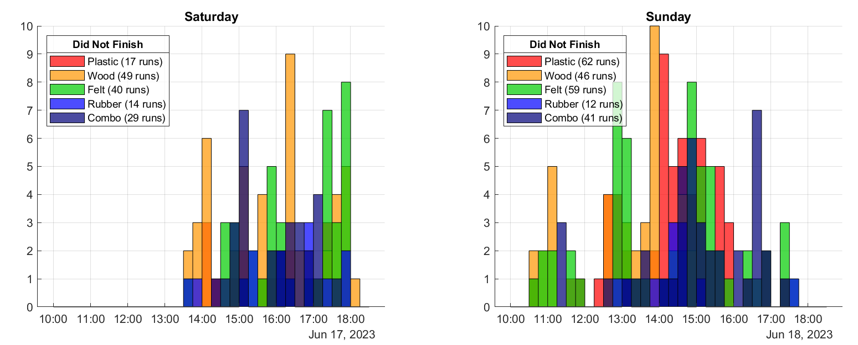
Distribution of Did Not Finish by Material
All 5 materials were, at different times, most frequent to not finish, for a variety of reasons including cars hitting the sides, solenoids failing to release, being assigned to a track not in use

